Slide 1
IoT BASED SMART IRRIGATION SYSTEM
GROUP NUMBER:8
TEAM MEMBERS: 1. Ashwini Salunke
2. Kavita Patel
3. Yatin Kalra
4. Deepak Sharma
GUIDE: Prof. Rahul Ambekar
CO-GUIDE: Prof. Vishal Badgujar

Slide 2
ABSTRACT
In this project “Smart Irrigation System” with embedded technology and IoT we have designed automated irrigation system for the Indian scenario.
Our system is able to deliver optimal water to plants based on moisture , light and temperature levels which are obtained through sensors.
The farmer will be able to monitor the parameters through the mobile app which is integrated with cloud storage.

Slide 3
INTRODUCTION
Agriculture is the backbone of Indian economy and also biggest sector which amounts to about 70% water consumption.
Though there are different advancements in technology, farmers prefer continuing with their traditional irrigation procedures.
In this project we are using Internet Technology & sensors network through which we can control water wastage.

Slide 4
continued
IOT is network technology where in a mobile device can be used to monitor the functions of device.
In this project we are storing data to cloud storage, through which we can access and modify our data easily.
This project helps the farmers to irrigate the farmland in an efficient manner with automated irrigation system based on soil moisture

Slide 5
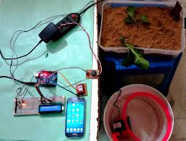
OBJECTIVES
Our goal in this project is to help the farmers with their crop yields by using mobile app.
To use water resource as effectively and optimal as possible.

Slide 6
LITERATURE REVIEW
There have been many studies done on the area of smart irrigation system.
Sr. No | Name | Merits | Demerits
1 | Rajalakshmi.P and Mrs.S. Devi Mahalakshmi | First to introduce the concept storing sensor data to database. | Data transmission is not secure ,data can lose in between transmission.
2 | Jia Uddin | The entire system is driven using solar power to overcome the use of electricity. | Involves two levels of decision making to turn the motor ON/OFF
3 | R. Suresh | This system is based on microcontroller application that results in lower power consumption. | Involves interfacing of two communicating devices to turn the motor on and off.

Slide 7
PROBLEM DEFINITION
PROBLEM: System can also potentially over-water a lawn if the irrigation system waters during one part of the day and then there is rainfall in another part of the day
POTENTIAL SOLUTION: 1) System can determine the best days to water during the course of a week.
2) Determine total water volume/rain fall to prevent over-watering.
3) The controller program and setting can be defined or modified through a web interface.
CHALLENGES: 1) Finding a way to interface to weather forecast information to the control unit.
2) It might also be difficult to capture the rainfall volume.

Slide 8
PROPOSED SYSTEM
Our system consists of three sensors each of this are designed to have threshold values that are divided into different levels in our code :
Soil moisture sensor: Measures the amount of moisture content present in the soil.
Temperature sensor: Records the temperature of the surroundings.
Luminosity sensor: Used to measure the intensity of light falling on the plant.
4) Arduino Uno: The sensors are interfaced to Arduino Uno which is a 14 I/O pin. It is used to interface all the sensors and actuators conveniently. It is also interfaced with the Wifi module and Bluetooth module.The Arduino is where all code is dumped.

Slide 9
PROPOSED SYSTEM
5) Relay and pump: Controlled by interfacing it to a microcontroller, The pump is triggred ON/OFF by the relay.
6) Wi-Fi module: Used to transmit all the data from sensors to the cloud storage.
7) Cloud : It is free open source service provides space to store and analyse data.

Slide 10
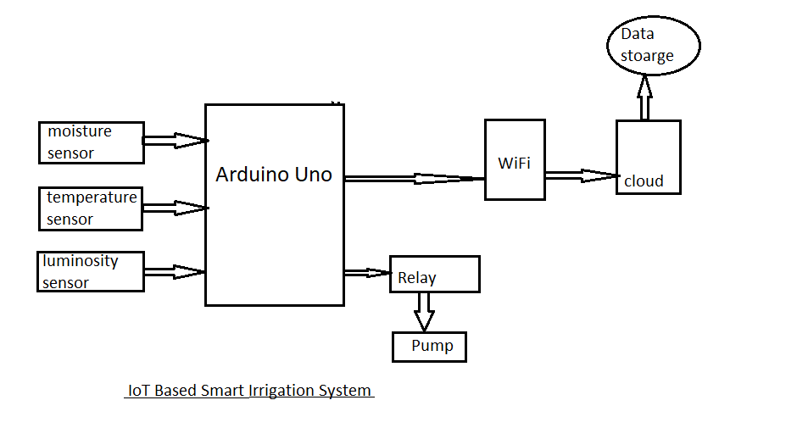
ARCHITECTURE

Slide 11
PEOJECT SCOPE
The automated irrigation system helps to optimize the use of water for irrigation purpose. The water consumption will be reduced with the implementation of soil-moisture based automated irrigation system
The technique can be used for application of accurate amount of fertilizer, water, pesticide etc. to enhance productivity and excellence.
Alarm System can be used to alert the Farmer/Land Owner in case of any Unusual activities on the field
Providing Different types of Irrigation according to crops

Slide 12
CONCLUSION
The irrigation system uses optimal resources to improve the efficiency of the irrigation.
According to the soil parameters the automation is achieved by turning the motor on and off using threshold values embedded in the code.
The status of the same is alerted to the users through messages. The same principle is also extentend to access the data from cloud.
The extension of this project can be use of solar panels in the project to run the motor to save energy.

Slide 13
REFERENCES
[1] R.Suresh, S.Gopinath, K.Govindaraju, T.Devika, N.SuthanthiraVanitha, “GSM based Automated Irrigation Control using Raingun Irrigation System”, International Journal of Advanced Research in Computer and Communication Engineering Vol. 3, Issue 2, February 2014.
[2] P. Rajalakshmi and S Devi Mahalakshmi “IOT Based Crop- Field Monitoring And Irrigation Automation” Intelligent Systems and Control (ISCO), 2016 10th International conference
[3] Joaquín Gutiérrez, Juan Francisco Villa-Medina, Alejandra Nieto-Garibay, and Miguel Ángel Porta-Gándara “Automated Irrigation System Using a Wireless Sensor Network and GPRS Module” IEEE TRANSACTIONS ON INSTRUMENTATION AND MEASUREMENT, VOL. 63, NO. 1, JANUARY 2014

Slide 14
THANK YOU

